Slide 1
A Convex Optimization Approach to Conformal Risk Control
Amin Abdipour
Dr. Mazlaghani

Slide 2


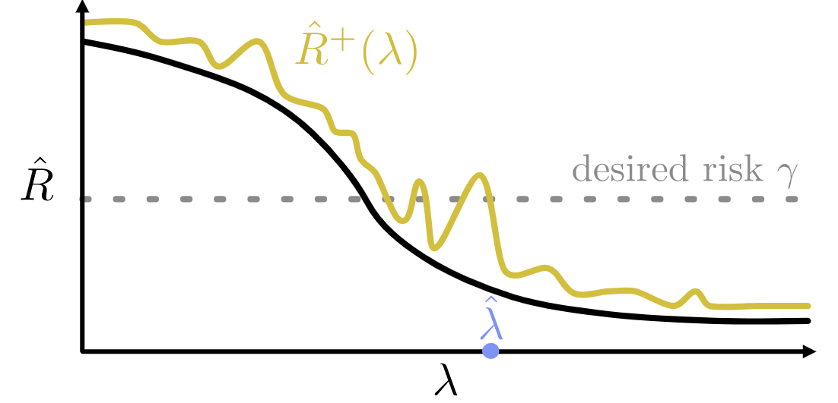

Risk-Controlling Prediction Sets (RCPS)
Goal: Improve RCPS
Department of Computer Engineering
2

Slide 3
Diffusion models: Score-based generative models
Use score function
Example: VAE
Department of Computer Engineering
3

Slide 4
Stochastic Differential Equation
Drift & Diffusion functions
$$dx=\left[h\left(x , t\right)−{g\left(t\right)}^{2}∇_{x}​log{p​}_{t}\left(x\right)\right]dt+g\left(t\right)d\overline{w}$$
$$∇_{x} log {p​}_{t}\left(x | y\right) =∇_{x} log {p​}_{t}\left(y | x\right)+∇_{x} log {p​}_{t}\left(x\right)$$
Department of Computer Engineering
4

Slide 5
Risk-Controlling Prediction Sets (RCPS)
Goal: Improve RCPS
Department of Computer Engineering
5

Slide 6
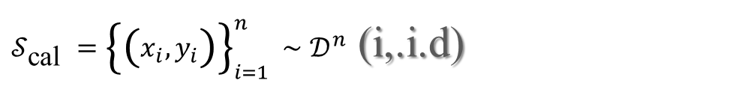
Conformal risk control
$𝒮_{\text{cal} }={\left\{\left(x_{i},y_{i}\right)\right\}}_{i=1}^{n}∼𝒟^{n}$ (i,.i.d)
$$ℙ_{𝒮_{\text{cal} }}\left[𝔼_{(x,y)∼𝒟}[𝓁(x,ℐ(y))]≤ε\right]≥1−δ.$$
$$ℐ\left(y\right)⊂ℐ^{′}\left(y\right)⟹𝓁\left(x,ℐ^{′}\left(y\right)\right)≤𝓁\left(x,ℐ\left(y\right)\right).$$
Department of Computer Engineering
6

Slide 7



K-RCPS
Loss & Risk
$$𝓁^{01}\left(x,ℐ\left(y\right)\right)=\frac{1}{d}\sum_{j∈\left[d\right]}{ }𝟙\left[x_{j}∉ℐ(y)_{j}\right],$$
$${if 𝒰(y)=[0,1]^{d}: R}^{01}(λ)=𝔼\left[𝓁^{01}(x,𝒰(y))\right]=0$$
$$\overline{I}\left(λ\right)=\frac{1}{d}\sum_{j∈\left[d\right]}{ }\left({\hat{u}}_{j}−{\hat{l}}_{j}\right)+2λ,$$
$$\hat{λ}=\underset{λ∈Λ}{\arg{min}}\overline{I}\left(λ\right)$$
$$\text{s}\text{.}\text{t}\text{. }{\hat{R}}^{01+}\left(λ^{′}\right)<ε,∀λ^{′}≥λ\left(P_{1}\right)$$
Department of Computer Engineering
7

Slide 8
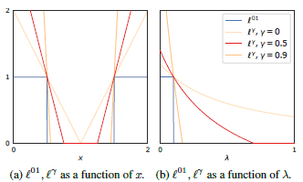

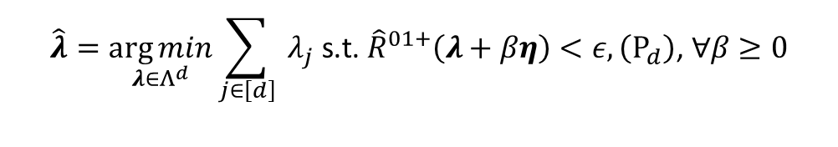


K-RCPS
Optimization Problem
$$\hat{λ}=\underset{λ∈Λ^{d}}{\arg{min}}\sum_{j∈\left[d\right]}{ }λ_{j} \text{s}\text{.}\text{t}\text{. }{\hat{R}}^{01+}\left(λ+βη\right)<ε,\left(P_{d}\right)\text{, }∀β≥0$$
$$\hat{λ}=\underset{λ∈Λ^{d}}{\arg{min}}\sum_{j∈[d]}{ }λ_{j} \text{s}\text{.}\text{t}\text{. }{\hat{R}}^{+}(λ+βη)<ε$$
$$𝓁^{γ}\left(x,ℐ_{λ}\left(y\right)\right)=\frac{1}{d}\sum_{j∈\left[d\right]}{ }{\left[\frac{2\left(1+q\right)}{I(λ)_{j}}\left|x_{j}−c_{j}\right|−q\right]}_{+},$$
$${\tilde{λ}}_{K}=\underset{λ∈Λ^{K}}{\arg{min}}\sum_{k∈[K]}{ }n_{k}λ_{k} \text{s}\text{.}\text{t}\text{. }{\hat{R}}^{γ}(Mλ)≤ε,\left(P_{K}\right)$$
Department of Computer Engineering
8

Slide 9
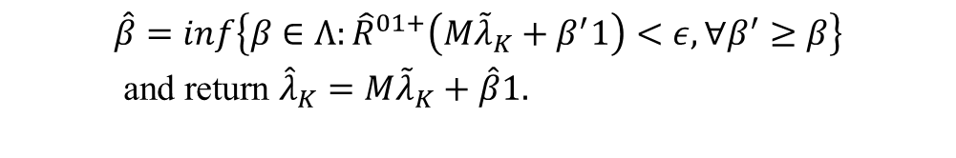
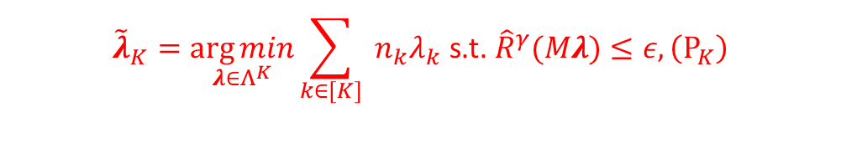
$${\tilde{λ}}_{K}=\underset{λ∈Λ^{K}}{\arg{min}}\sum_{k∈[K]}{ }n_{k}λ_{k} \text{s}\text{.}\text{t}\text{. }{\hat{R}}^{γ}(Mλ)≤ε,\left(P_{K}\right)$$
K-RCPS
$$\begin{aligned}&\hat{β}=inf\left\{β∈Λ:{\hat{R}}^{01+}\left(M{\tilde{λ}}_{K}+β^{′}1\right)<ε,∀β^{′}≥β\right\} \\ & \text{and} \text{return} {\hat{λ}}_{K}=M{\tilde{λ}}_{K}+\hat{β}1.\end{aligned}$$
$$K−RCPS= RCPS+M{\tilde{λ}}_{K}+β1$$
Department of Computer Engineering
9

Slide 10
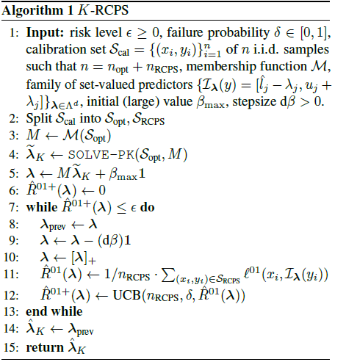
K-RCPS
Department of Computer Engineering
10

Slide 11
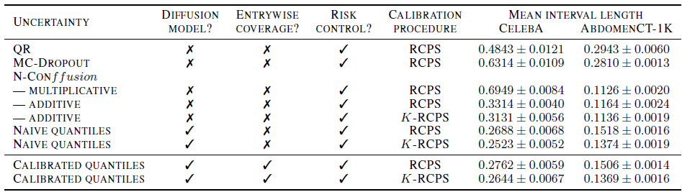
Results
Department of Computer Engineering
11

Slide 12

Thanks for your attention

